Slide 1

NextHikes IT Solutions
Project:-2
Represented By:-
Kavira Raju
Data

Slide 2
Work Process
Loading Data Set 1
Preprocess Dataset-1
Visualize Dataset-1
Preprocess Dataset-2
Visualize Dataset-2
Merge Dataset-1 and Dataset-2
Preprocess and Visualize merging data
Preprocess Dataset-3
Visualize Dataset-3
Integration of Dataset-3 and merging data
Final Preprocessing and Visualization

Slide 3
Dataset preprocessing
Data loading info: head, tail, describe, duplicates, Handle missing data, data cleaning, outliers
Feature Engineering: extract features.
Normalization/Scaling.
Tools/Technologies:
Tools like uses Python (pandas, NumPy, matplotlib, seaborn) etc. Before and after Snapshot
Show a table or graph highlighting raw vs. cleaned data.

Slide 4
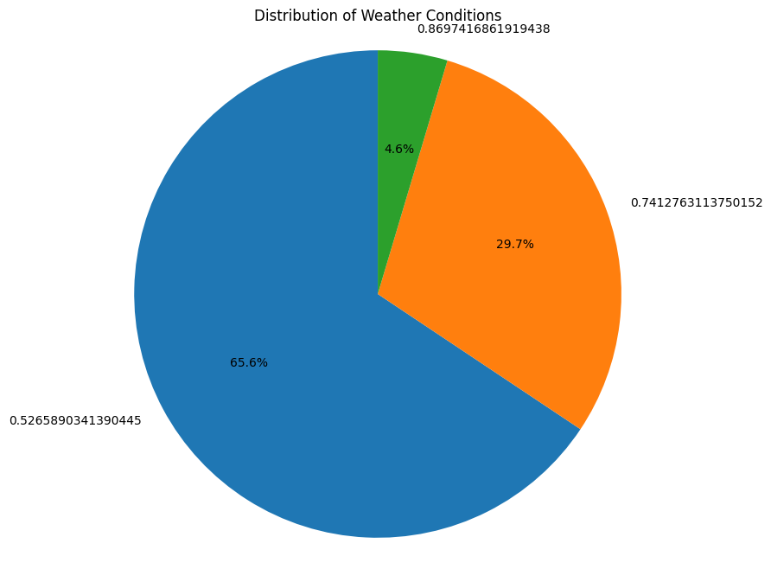
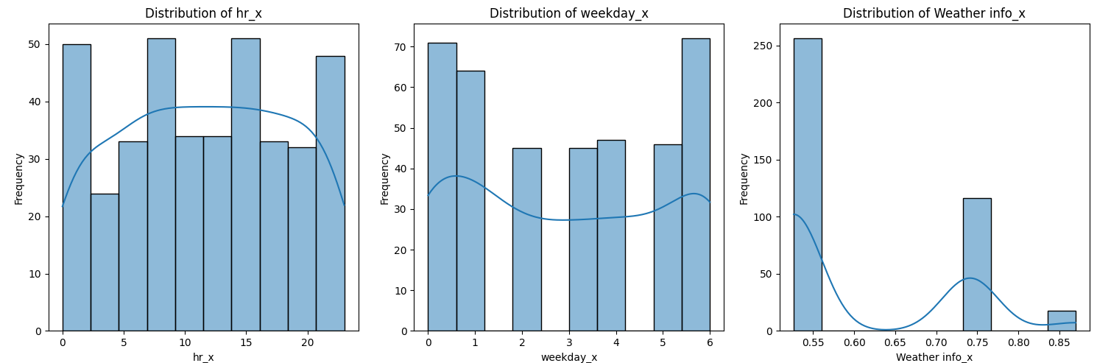
Data visualization
Insights updated in notebook due to space I can’t
wrote.
Sorry for not updated pls go with notebook

Slide 5
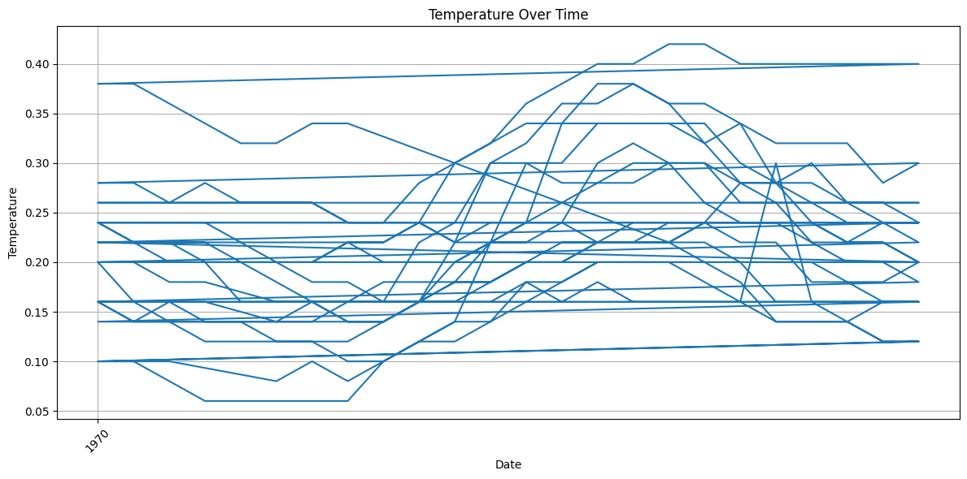
Merging Datasets : Processing
Handling Missing Data: Fill or remove rows with missing values in columns.Data Transformation: Normalize/standardize numerical values (temp, atemp) and encode categorical data (season, holiday, etc.).
Feature Engineering: Extract features from hour month.
Tool/Technologies: Same dataset.
Visualization Insights : Key: Temperature Trends Over Hour.
Type: Line plot
Insight: Temperature fluctuates across the hour and varies by season.

Slide 6
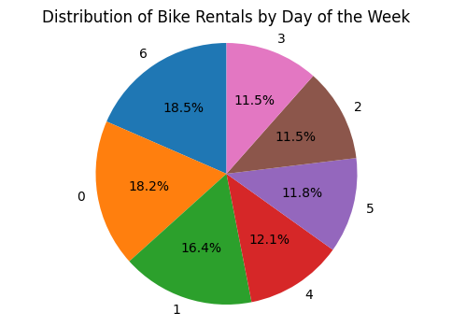
Integration of Dataset-3
Process: Concatenation logic is used to combine data from multiple sources for
a comprehensive analysis, and all methods remain the same.
Tools Used: The same tools are used.
Snapshot: Snapshots are taken before and after concatenation.
Visualization dataset: The process is similar to dataset-1.

Slide 7
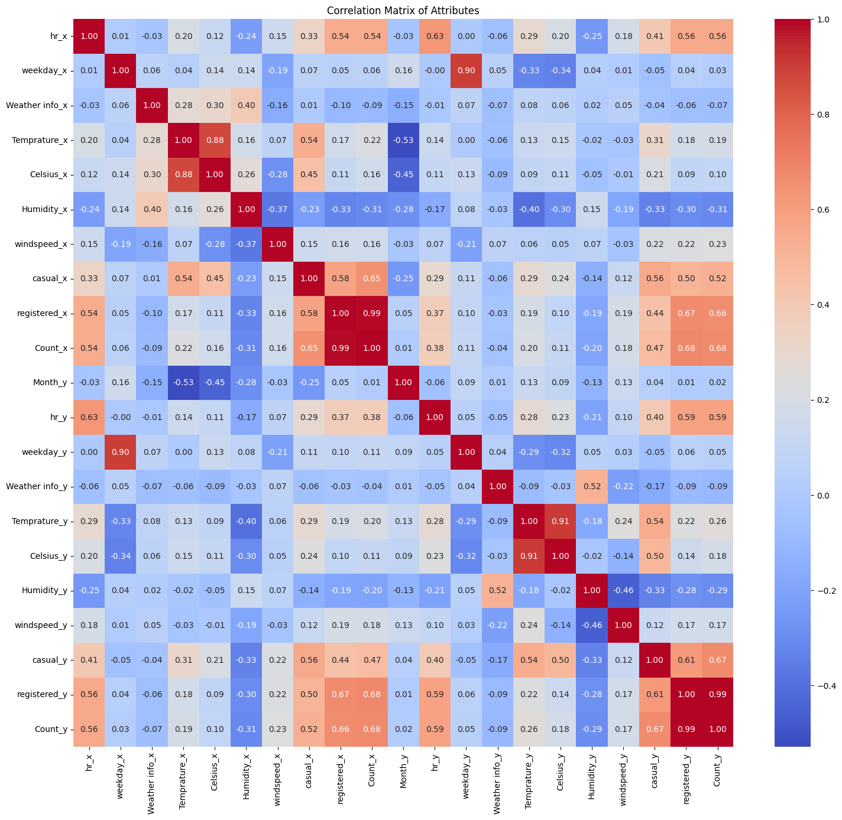
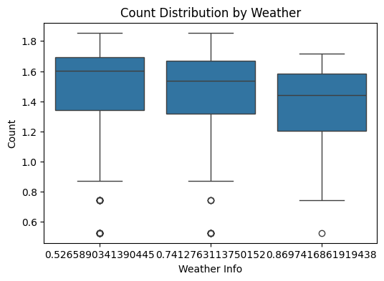
Final preprocessing and visualization
Processing all data types consistently, with some changes noted.
Key values involved preprocessing the dataset by cleaning, transforming,
and creating new features for better analysis.
Visualization revealed trends in seasonal demand, hourly activity,
and the impact of weather on rentals.
Insights are used for understanding user behavior and optimizing resources.
Visualization methods include heatmap correlation matrix, trend analysis,
and box plots.

Slide 8
Challenges and solutions
Challenges Faced: Missing data, format inconsistencies.
Solutions Implemented: Strategies like imputation and
scaling are used to address these challenges.

Slide 9
Result after analysis data:-
The future scope of bike rentals includes:
Predictive Analytics: Developing models to predict bike rental demand based on weather and time.
Demand Optimization: Analyzing data to optimize bike availability in high-demand areas.
Real-Time Monitoring: Implementing dashboards for tracking rentals and weather conditions.
Environmental Benefits: Assessing the impact of bike rentals on reducing carbon emissions.

Slide 10
Conclusion
The dataset was successfully preprocessed by handling missing data, outliers, and transforming features.
Visualizations revealed key insights into temperature trends, seasonal demand, and the impact of weather on bike rentals.
The analysis highlights the importance of data-driven decision-making for optimizing bike-sharing systems.
Future enhancements can include predictive models and real-time monitoring for better service efficiency.

Slide 11
NextHikes IT Solutions
THANK YOU
WARM REGARDS
KAVIRA RAJU

